Slide 1
Digestion in intestines
1

Slide 2
Small Intestine
It is a highly coiled structure.
The length of the small intestine is almost 7.5m.
The liver and pancreas release digestive juices into the small intestine.
The inner lining of the intestine also secretes some digestive juices on its own.
The small intestine breaks the carbohydrates into glucose, fats into fatty acids and proteins into amino acids.

Slide 3
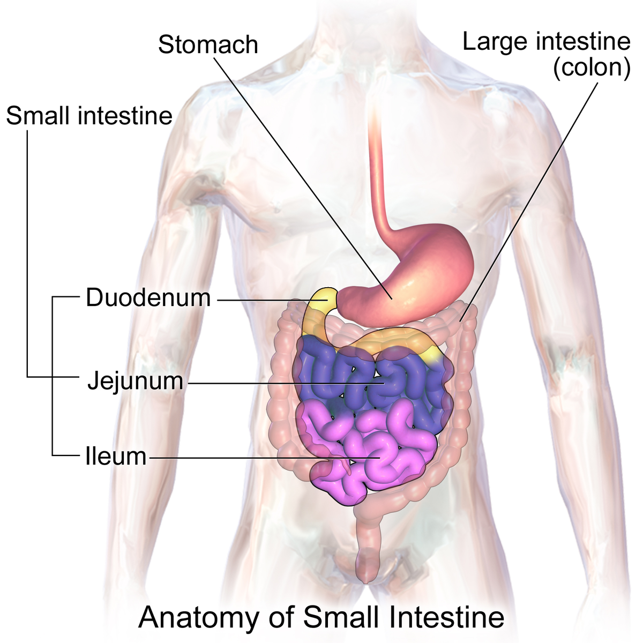
Parts of Small Intestine
1. Duodenum
It is the first part of the small intestine whose main function is to initiate the digestive process. In this process, the food that enters the small intestine from the stomach is mixed with the digestive juices (bile and pancreatic juice) and is further broken down into simpler substances.
2. Jejunum
It is the middle part of the small intestine that contains the villi and hence undergoes absorption and assimilation.
3. Ileum
It is the third and last part of the small intestine that contains villi-like structures. The ileum absorbs vitamin B12, bile acids and any other nutrients present in the food.

Slide 4
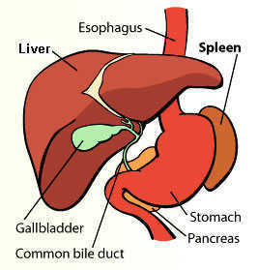
The Liver
It is a gland reddish brown in colour.
It is known as the largest gland of the human body.
It secretes a digestive juice called bile juice.
The bile juice is stored in the gallbladder.
The bile juice makes it possible for the body to digest the fats.

Slide 5
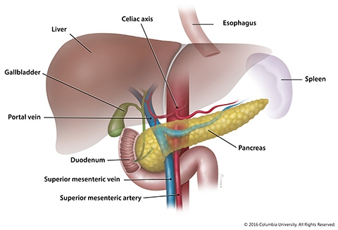
The Pancreas
It is a cream coloured gland present in the human body.
It secretes pancreatic juice that helps in digestion of fats, carbohydrates and proteins.

Slide 6
How small intestine absorbs food?
Absorption: it is a process by which the digested food enters the blood vessels of the small intestine.
Villi in the intestine: the small intestine contains small finger-like structures called Villi. They increase the surface area of the intestine thereby increasing the amount of absorption. The digested food gets into the blood vessels through villi and then reaches the whole body.

Slide 7
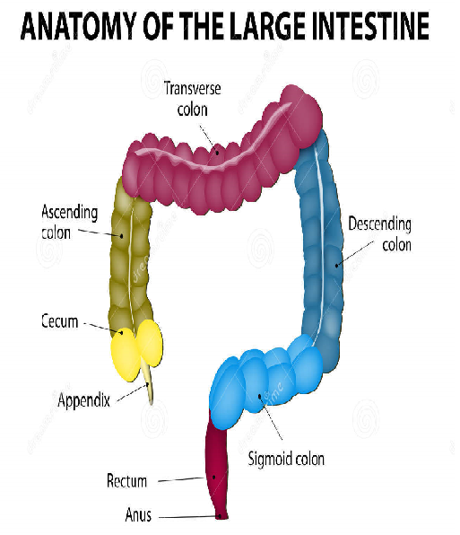
The Large Intestine
Any food that is left undigested passes through the small intestine and enters the large intestine.
It is a wide tube-like structure.
It is only 1.5 m long.
The main function of the large intestine is to absorb water and salts from the undigested food.
The rest of the waste, undigested food passes through the rectum.
Egestion: The process by which the waste, undigested food (the faecal matter) get out of the body through the anus.

